Slide 1
Predicting the best location to open restaurant in Lahore
By: Arslan Ghazi

Slide 2
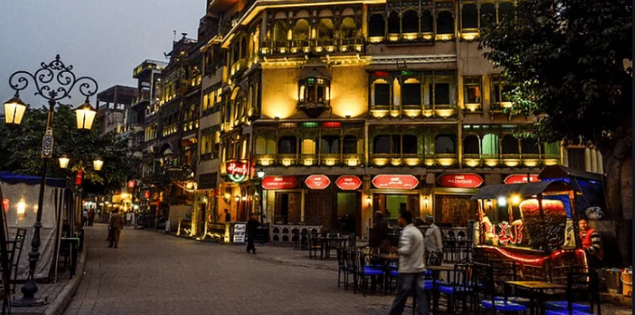
Lahore is one of the biggest Cities in Pakistan and famous for its food
A Potential Investor wants to open food Business in Lahore

Slide 3
Description of Problem
A Potential Investor wants to open food Business in Lahore

Slide 4
Methodology
Step1: Longitude and latitude coordinates of Lahore are utilized and four square logarithm is run to acquire data of restaurants of Lahore
Step2: Data is cleaned, normalized and represented in a data frame
Step3: Using folium maps; restaurants are represented on Lahore’s map and their location is visible by blue markers

Slide 5
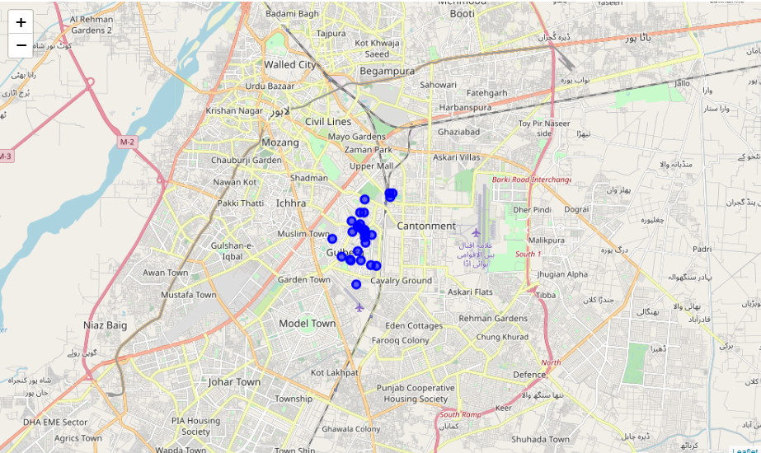
Folium Map Showing results in Lahore

Slide 6
Recommendations and Observations
Overall Results reflect the ideal location to open restaurant is Gulberg correctly
Some of the smaller restaurants that are not available in four Square API are not considered hence some cheaper locations are not available

